Slide 1
1.3. Pipeline
Part 1. Data Preparation
Part 2. Model Construction
Part 3. Presentation
Notes:
http://cacm.acm.org/blogs/blog-cacm/169199-data-science-workflow-overview-and-challenges/fulltext
https://www.lynda.com/Big-Data-tutorials/Pipeline/420305/505106-4.htmlChart

Slide 2





1.3. Pipeline
Part 1. Data Preparation
1. Collect
Existing Database
API
Scraping
Creating
Notes:
http://cacm.acm.org/blogs/blog-cacm/169199-data-science-workflow-overview-and-challenges/fulltext
https://www.lynda.com/Big-Data-tutorials/Pipeline/420305/505106-4.html
https://www.siteground.com/kb/what_is_data_scraping_and_how_can_i_stop_it/ https://www.promptcloud.com/data-scraping-vs-data-crawling/

Slide 3
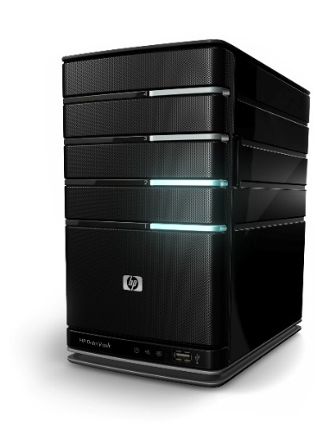


1.3. Pipeline
Part 1. Data Preparation
1. Collect
2. Store
Local or Cloud

Slide 4
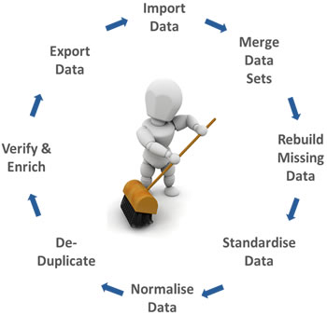
1.3. Pipeline
Part 1. Data Preparation
1. Collection
2. Storage
Local or Cloud
3. Cleaning
Noise
Outlier
Missing
Standardize
Normalize
https://media.licdn.com/mpr/mpr/shrinknp_400_400/p/1/005/0b9/0f2/22e0a9b.jpg

Slide 5
1.3. Pipeline
Part 2. Model Construction
4. Feature Engineering
Images ----> pixels, contours, textures, etc.
Signal ----> samples, spectrograms, etc.
Time series ----> ticks, trends, reversals, etc.
Biological data ----> DNA, markers sequences, genes, etc.
Text data ----> words, grammatical classes and relations, etc.
Check the similar features.
Reduce the number of features.
http://www.cs.princeton.edu/courses/archive/spring10/cos424/slides/18-feat.pdf

Slide 6
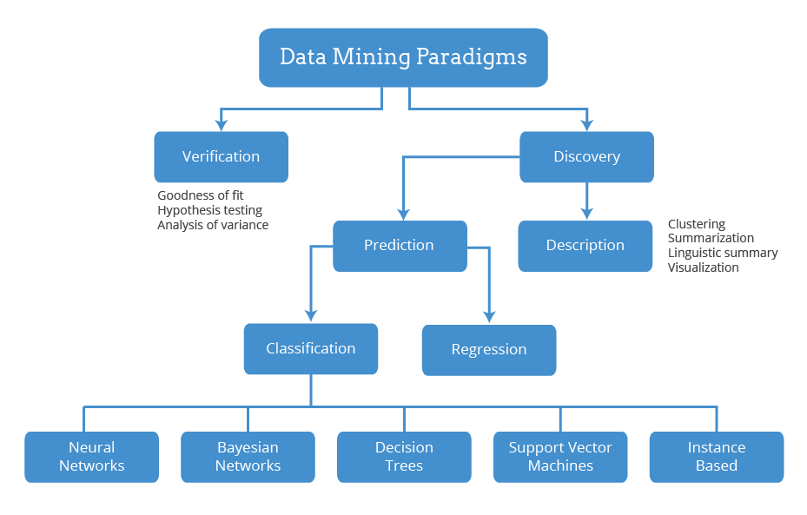
1.3. Pipeline
Part 2. Model Construction
4. Feature Engineering
5. Model Selection
http://betterevaluation.org/sites/default/files/Data%20Mining%20Paradigms.png

Slide 7

1.3. Pipeline
Part 2. Model Construction
4. Feature Engineering
5. Model Selection
http://betterevaluation.org/sites/default/files/Data%20Mining%20Paradigms.png

Slide 8
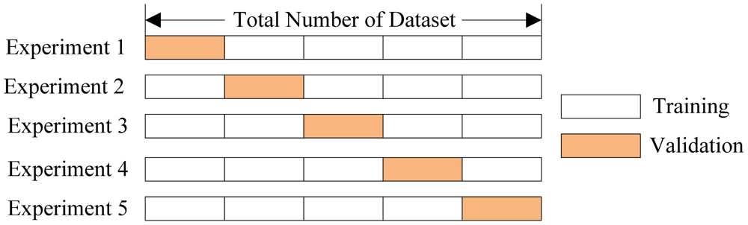
1.3. Pipeline
Part 2. Model Construction
4. Feature Engineering
5. Model Selection
6. Model Validation
https://i.stack.imgur.com/1fXzJ.png

Slide 9
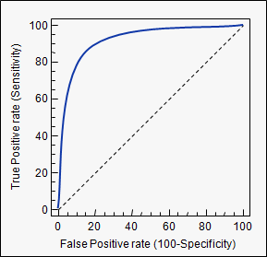
1.3. Pipeline
Part 2. Model Construction
4. Feature Engineering
5. Model Selection
6. Model Validation
7. Model Evaluation
https://www.medcalc.org/manual/_help/images/roc_intro3.png

Slide 10
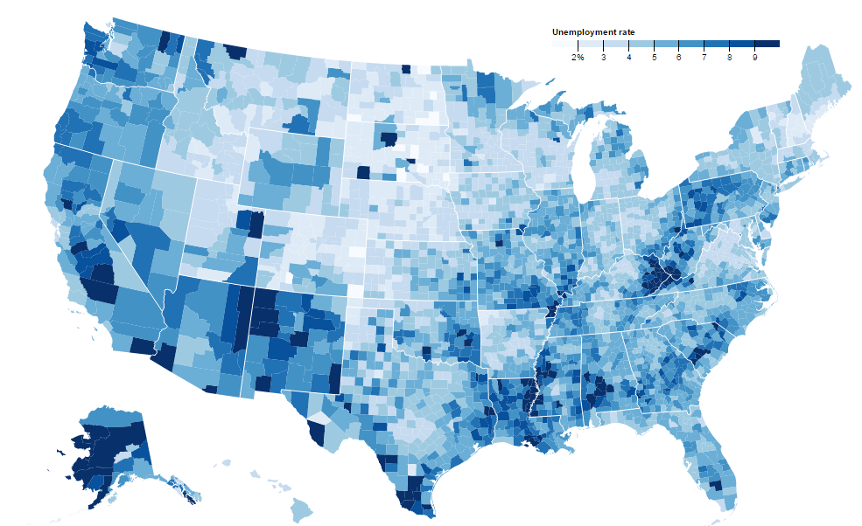
1.3. Pipeline
Part 3. Presentation
8. Visualization
Unemployment rates as of August, 2016
https://bl.ocks.org/mbostock/4060606
Notes:
http://cds.nyu.edu/wp-content/uploads/2014/04/bertini_datascience_showcase_May12_2014.pdf
Lynda: importance of visualization.

Slide 11
1.3. Pipeline
4, Feature Engineering
1, Collection
5, Model Selection
2, Storage
8, Visualization
Deployment
6, Model Validation
3, Cleaning
7, Model Evaluation
Data Preparation
Model Construction
Presentation
Deployment
Notes:
http://www.datasciencecentral.com/profiles/blogs/bubu

Slide 12
2.2. Programming
Package
NumPy | N-dimensional Array Operation, etc.
SciPy | Scientific Computing: Linear Algebra, Optimization, Statistics, etc.
Pandas | Data Structure & Analysis (SQL style): Select, Join, Merge, GroupBy, etc.
Scikit-learn | Machine Learning.
Matplotlib | Plotting.
seaborn | Statistical Data Visualization.

Slide 13
2.3. Machine Learning
Classification: decision tree
Clustering: kmeans, hierarchy
Association Rule: apriori principle
Regression: linear

Slide 14
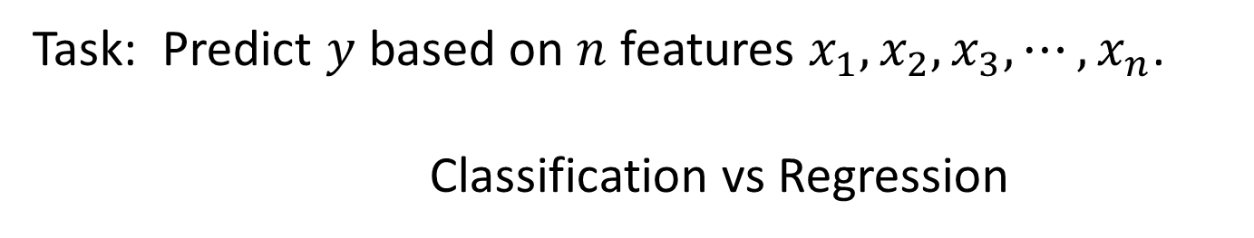
2.3. Machine Learning
Task: Predict $y$ based on $n$ features $x_{1},x_{2},x_{3}, ⋯,x_{n}$.
Classification vs Regression
 | Classification | Regression
y | Qualitative (Categorical) : Discrete Values | Quantitative: Continuous Values.
Examples | Yes or No, Colors, Sick or Health…. | Product Prices, Temperature, Income ….

Slide 15
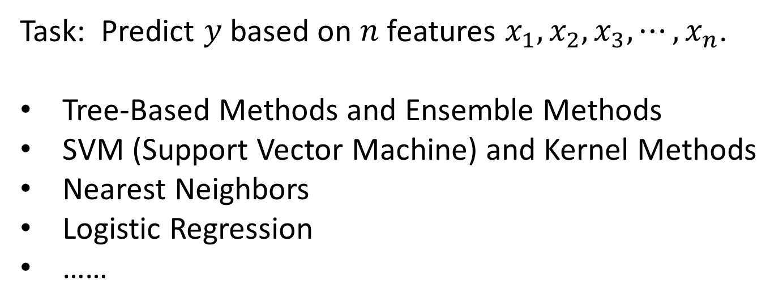
2.3. Machine Learning
Task: Predict $y$ based on $n$ features $x_{1},x_{2},x_{3}, ⋯,x_{n}$.
Tree-Based Methods and Ensemble Methods
SVM (Support Vector Machine) and Kernel Methods
Nearest Neighbors
Logistic Regression
……

Slide 16
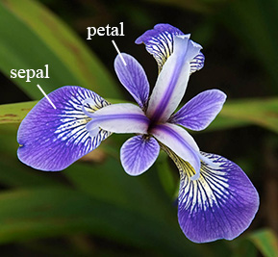
Real Application: Iris flower data set
2.3. Machine Learning
https://www.math.umd.edu/~petersd/666/html/iris_with_labels.jpg

Slide 17
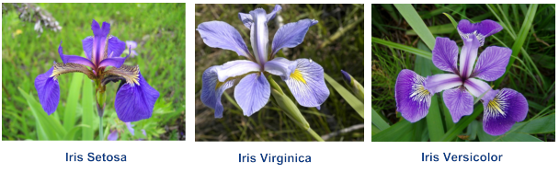
Real Application: Iris flower data set
2.3. Machine Learning
https://c.mql5.com/2/3/Figure10_Iris_flower.png

Slide 18
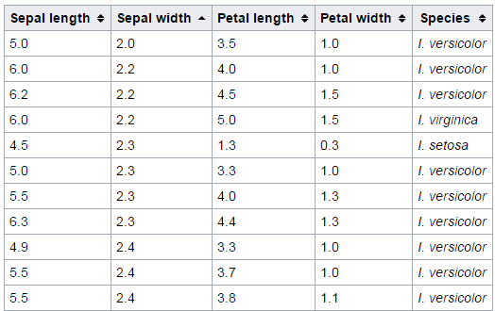
Real Application: Classification Task
2.3. Machine Learning
150 Samples

Slide 19
2.3. Machine Learning: Decision Tree
petal-length
<=2.6
>2.6
Feature | Value
Sepal Length | 5.0
Sepal Width | 2.0
Petal Length | 3.5
Petal Width | 1.0
Iris-setosa
petal-width
>1.65
<=1.65
petal-length
Iris-virginica
<=5
>5
Iris-versicolor
sepal-length
<=6.05
>6.05
Iris-versicolor
Iris-virginica

Slide 20
2.3. Machine Learning: Decision Tree
petal-length
<=2.6
>2.6
Feature | Value
Sepal Length | 5.0
Sepal Width | 2.0
Petal Length | 3.5
Petal Width | 1.0
Iris-setosa
petal-width
>1.65
<=1.65
petal-length
Iris-virginica
<=5
>5
Iris-versicolor
sepal-length
<=6.05
>6.05
Iris-versicolor
Iris-virginica

Slide 21
2.3. Machine Learning: Decision Tree
petal-length
<=2.6
>2.6
Feature | Value
Sepal Length | 5.0
Sepal Width | 2.0
Petal Length | 3.5
Petal Width | 1.0
Iris-setosa
petal-width
>1.65
<=1.65
petal-length
Iris-virginica
<=5
>5
Iris-versicolor
sepal-length
<=6.05
>6.05
Iris-versicolor
Iris-virginica

Slide 22
2.3. Machine Learning: Decision Tree
petal-length
<=2.6
>2.6
Feature | Value
Sepal Length | 5.0
Sepal Width | 2.0
Petal Length | 3.5
Petal Width | 1.0
Iris-setosa
petal-width
>1.65
<=1.65
petal-length
Iris-virginica
<=5
>5
Iris-versicolor
sepal-length
<=6.05
>6.05
Iris-versicolor
Iris-virginica

Slide 23
2.3. Machine Learning: Decision Tree
petal-length
<=2.6
>2.6
Feature | Value
Sepal Length | 5.0
Sepal Width | 2.0
Petal Length | 3.5
Petal Width | 1.0
Iris-setosa
petal-width
>1.65
<=1.65
petal-length
Iris-virginica
<=5
>5
Iris-versicolor
sepal-length
<=6.05
>6.05
Iris-versicolor
Iris-virginica

Slide 24
Algorithms:
2.3. Machine Learning: Decision Tree
ID3 (Iterative Dichotomiser 3)
C4.5 (successor of ID3)
CART (Classification And Regression Tree)
….

Slide 25
Drawbacks:
2.3. Machine Learning: Decision Tree
Overfitting because of noise and outlier
High variance: slight change of input may result in different answers.
Instability: a small change in input data can cause large change in the tree.

Slide 26
2.3. Machine Learning: Ensemble
Ensemble: Wisdom of the crowd.
1, Build many trees.
2, Do majority vote.

Slide 27
2.3. Machine Learning: Ensemble
Bagging: Build trees based on different randomly drawn datasets.
Build Decision Tree
Randomly draw 100 flowers
Tree 1
Build Decision Tree
150 flowers
Randomly draw 100 flowers
Tree 2
Majority
Vote
Build Decision Tree
Randomly draw 100 flowers
Tree 100

Slide 28
2.3. Machine Learning: Ensemble
Bagging: Build trees based on different randomly drawn datasets.
Tree 1
These trees are built by same four features.
Some trees may be highly correlated
because they may be quite similar.
150 flowers
Tree 2
How could we build uncorrelated trees?
Tree 100

Slide 29
2.3. Machine Learning: Ensemble
Random Forest: Build trees based on subsets of features.
Build Decision Tree
Randomly draw
2 features
Tree 1
Build Decision Tree
4 features
Randomly draw
2 features
Tree 2
Majority
Vote
Build Decision Tree
Randomly draw
2 features
Tree 6
Notes:
Another method.

Slide 30
2.3. Machine Learning: Ensemble
Boosting: Each classifier puts greater weight on the previous one’s error.
Weak Classifier
…
Medium Classifier
…
Strong Classifier

Slide 31


2.3. Machine Learning: Ensemble
Question 1
Pay Less Attention
Question 1
Question 2
Pay More Attention
Question 2
Question 3
Pay More Attention
Question 3
Question 4
Pay Less Attention
Question 4
Question 5
Pay More Attention
Question 5
Do it again
Question 47
Pay More Attention
Question 47
Question 48
Pay More Attention
Question 48
Question 49
Pay More Attention
Question 49
Question 50
Pay More Attention
Question 50
Exam
Exam

Slide 32
2.3. Machine Learning: Ensemble
Question 1
Question 1
Question 2
Question 2
Question 3
Question 3
Question 4
Question 4
Question 5
Question 5
Repeat Many Times
Question 47
Question 47
Question 48
Question 48
Question 49
Question 49
Question 50
Question 50
Exam
Exam

